Slide 1
A Computational Model of Genre
Allyn Waller
allyn.waller@stanford.edu | https://github.com/AllynWaller
Society for Classical Studies 2021 Annual Meeting

Slide 2
Outline
- Literary models of genre
- Development of a computational model
- Disagreements between the two models
- Implications for future work
allyn.waller@stanford.edu A Computational Model of Genre SCS 2021

Slide 3
What is a genre? (Literary model)
- Top-down perspective
- Texts as instantiation of a genre
- Qualitative, large-scale patterns
- Text-level granularity
allyn.waller@stanford.edu A Computational Model of Genre SCS 2021

Slide 4
What is a genre? (Computational Model)
- A collection of words
- A collection of (citable) sections
- Assumes that difference between genres is due to a difference in vocabulary usage
allyn.waller@stanford.edu A Computational Model of Genre SCS 2021

Slide 5
Research Question
Can we predict the genre of a text based solely on the vocabulary used in an individual section of that text?
allyn.waller@stanford.edu A Computational Model of Genre SCS 2021

Slide 6
Developing the computational model
Focus on distinguishing Greek historiography from other (roughly) contemporaneous Greek prose
allyn.waller@stanford.edu A Computational Model of Genre SCS 2021

Slide 7
The Authors and Works
Historiography - c. 10,000 sections
- Herodotus
- Thucydides
- Xenophon
- Anabasis
- Hellenica
Non-Historiography - c. 9,000 sections
- Demosthenes
- Speeches
- Letters
- Isocrates
- Lysias
- Xenophon
- Memorabilia
- Economicus
- Symposium
- Apology
- Heiro
allyn.waller@stanford.edu A Computational Model of Genre SCS 2021

Slide 8
Building the Model
Input
Preprocessing
Training the Model
Output
Texts are sourced from the Perseus Digital Library as XML files. (https://www.github.com/PerseusDL)
Implementation of the Linear Regression algorithm from sklearn python package (https://scikit-learn.org/stable/)
allyn.waller@stanford.edu A Computational Model of Genre SCS 2021

Slide 9
Building the Model
Input
Preprocessing
Training the Model
Output
Extra data is stripped out, texts are divided into sections, and those sections are labeled as Historiography or Not Historiography.
No regularization, tokenizing, or lemmatizing of the text is performed.
allyn.waller@stanford.edu A Computational Model of Genre SCS 2021

Slide 10
Building the Model
Input
Preprocessing
Training the Model
Output
Count the vocabulary items in the section.
Multiply these counts by a weight representing how strongly that vocabulary item is linked to each category.
Add the weighted frequencies together.
allyn.waller@stanford.edu A Computational Model of Genre SCS 2021

Slide 11
Building the Model
Input
Preprocessing
Training the Model
Output
If weighted total of the section <0.5, predict Historiography.
Otherwise, predict Not Historiography.
If testing, record the prediction. If training, compare the prediction to the label and update the weights of the vocabulary items in the section.
allyn.waller@stanford.edu A Computational Model of Genre SCS 2021

Slide 12
Building the Model
Input
Preprocessing
Training the Model
Output
Two main outputs:
1. Predictions of the genre of each section
2. Weights for each vocabulary item
allyn.waller@stanford.edu A Computational Model of Genre SCS 2021

Slide 13
Levels of Agreement
Computational model → Literary model ↓ | Not Historiography | Historiography
Not Historiography | 8,352 | 733
Historiography | 488 | 10,042
Overall Agreement: 93.9%
allyn.waller@stanford.edu A Computational Model of Genre SCS 2021

Slide 14
Levels of Agreement by Author
Author | Hdt. | Thuc. | Xen. (Hist.) | Xen. (Dialogues) | Isoc. | Dem. | Lys. | Overall
Works | 1 | 1 | 2 | 5 | 30 | 63 | 34 | 136
Length (in sections) | 4338 | 3577 | 2615 | 1288 | 2116 | 4465 | 1116 | 19,615
Label | Hist. | Hist. | Hist. | Not Hist. | Not Hist. | Not Hist. | Not Hist. | -
Number of Mistakes | 16 | 71 | 401 | 400 | 55 | 100 | 178 | 1,221
% Mistakes in Genre | 3.28% | 14.55% | 82.17% | 54.57% | 7.50% | 13.64% | 24.28% | -
Overall Accuracy | 99.63% | 98.02% | 84.67% | 71.18% | 97.40% | 97.76% | 84.05% | 93.8%
Author | Hdt. | Thuc. | Xen. (Hist.) | Xen. (Other) | Isoc. | Dem. | Lysias
Length (in sections) | 4,338 | 3,577 | 2,615 | 1,388 | 2,116 | 4,465 | 1,116
Number of disagreements | 16 | 71 | 401 | 400 | 55 | 100 | 178
Percent agreement | 99.63% | 98.02% | 84.67% | 71.18% | 97.40% | 97.76% | 84.05%
allyn.waller@stanford.edu A Computational Model of Genre SCS 2021

Slide 15
Levels of Agreement by Author
allyn.waller@stanford.edu A Computational Model of Genre SCS 2021

Slide 16
Xenophon
Text | Anabasis | Hellenica | Memorabilia | Economicus | Symposium | Apology | Heiro
Length (in sections) | 1469 | 1146 | 608 | 397 | 196 | 34 | 153
Number of disagreements | 148 | 253 | 99 | 145 | 59 | 10 | 87
Percent agreement | 89.9% | 77.9% | 83.7% | 63.5% | 69.9% | 70.6% | 43.1%
allyn.waller@stanford.edu A Computational Model of Genre SCS 2021

Slide 17
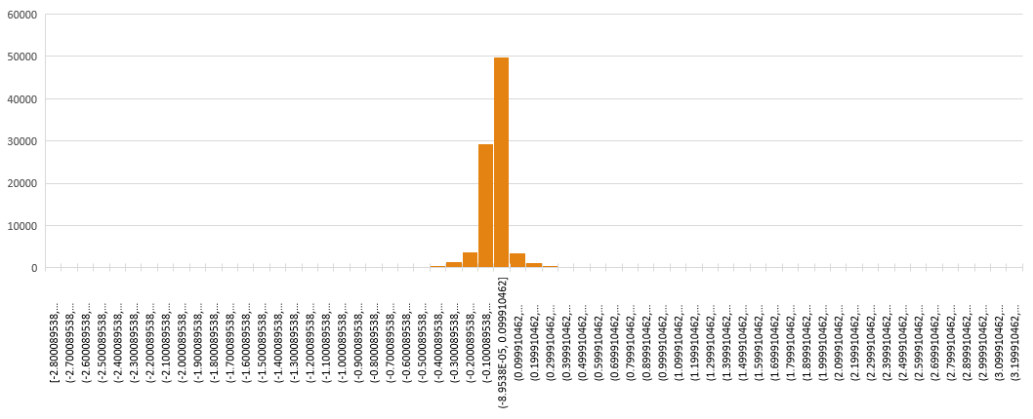
Distribution of Word Weights
allyn.waller@stanford.edu A Computational Model of Genre SCS 2021

Slide 18
Top 10 Lists
Associated with historiography
Associated with not historiography
ἐς | 3.227221 | ἐπεὶ | 1.456497
αἰεὶ | 1.639236 | σεύθης | 1.424517
ξενοφῶν | 1.60213 | στράτευμα | 1.419719
κῦρος | 1.467988 | τάδε | 1.412234
ἔφασαν | 1.457065 | ἀγησίλαος | 1.380875
ἱέρων | -1.3195 | τοίνυν | -1.5937
φίλιππος | -1.4126 | ἔφην | -1.77179
τύραννοι | -1.48477 | δικασταί | -2.18498
σωκράτην | -1.51662 | σώκρατες | -2.38528
ἀνθρώποις | -1.58418 | σωκράτης | -2.80009
allyn.waller@stanford.edu A Computational Model of Genre SCS 2021

Slide 19
What does this mean?
- Genre is real and impacts texts at all levels
- Quantitative and qualitative models of genre are complementary
allyn.waller@stanford.edu A Computational Model of Genre SCS 2021

Slide 20
Thank you!
allyn.waller@stanford.edu
https://github.com/AllynWaller
allyn.waller@stanford.edu A Computational Model of Genre SCS 2021

Slide 21
Future directions
- Expansion!
- More texts (diachronically, range of counterexamples, Latin?)
- More genres (non-binary classification, etc.)
- Digging deeper
- Separate training and testing texts in time
- Regularization of texts
allyn.waller@stanford.edu A Computational Model of Genre SCS 2021

